Slide 1
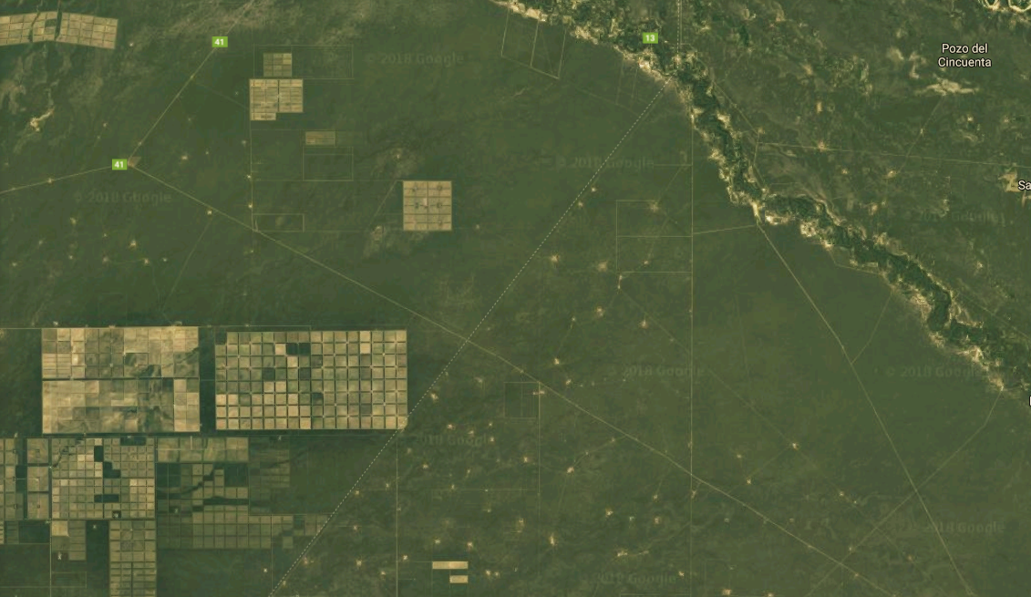

Systematic Conservation Prioritization using PrioritizR
Humboldt Universität Modul
Conservation Biogeography
Summer term 2018
Elizabeth Law

Slide 2

Agenda
Practical 1:
15 min Introduction: what is systematic conservation planning
30 min A first example of systematic conservation planning
40 min The NADC study area – data, gap analysis, basic prioritization, adding lock-in, or lock-outs, and connectivity
5 min Allocation of scenarios for practical 2
Homework: Think about your scenarios! Prepare some code to try, and research some of the discussion points.
Practical 2:
5 min Recap, system set up.
50 min Scenarios
30 min Class presentations (5 min / group)

Slide 3
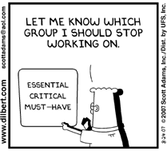
What is Systematic Conservation Prioritization?
What conservation actions?
Where? When?
WHY?
Limited resources, time, and (too) many species to save.
Complex problems – no simple/intuitive answers, trade-offs

Slide 4
What is Systematic Conservation Prioritization?
WHY?
Limited resources, time, and (too) many species to save.
Complex problems– no simple/intuitive answers, trade-offs
HOW?
Trade-offs mean that decisions can be ‘contested’
Evidence based, repeatable, transparent
WHAT?
Be effective, by being representative of ‘biodiversity’
Minimize trade-offs/conflict by being efficient (complementarity)

Slide 5
Example
Study area
3
Planning units
2
2
Budget = 3 units
Species Richness
3
5
1
Complementarity

Slide 6
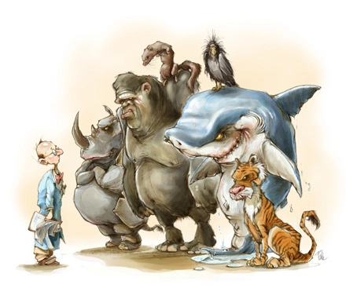
Triage
Should we give up on species that are ‘too costly’ to save??
This is a really current, critical ethical problem
Rigorous argument needs information:
we need to understand prioritization
Wilson, K.A., Law, E.A. (2016) Ethics of conservation triage. Frontiers in Ecology and Evolution 4:112
Cartoon found without attribution on https://conservationbytes.com

Slide 7
Elements of a prioritization
An objective(s): what do you want to minimize or maximize?
A list of available options: e.g. conservation actions in space and time.
Information on benefits: what each of the actions will achieve for each feature.
Information on costs: how much each action will cost.
(optional) Information on other constraints: e.g. threshold targets to achieve, budgets not to go over, areas that need to be ‘locked in’ to certain actions, or ‘locked out’ from other options.

Slide 8
A small example:
Objective: Minimize cost of reserve network
A list of available options: Planning units (pu) in reserves
Benefits: what each of the pu will achieve for each feature (species).
Costs: how much each pu will cost
Constraints: threshold targets to achieve = 17% of the total possible of each species.

Slide 9
Software & Data
We will be using R, and several contributed packages, including Prioritizr.
This is because R has options for many of the latest analyses, and allows streamlined analyses across GIS and optimization.
This is a course about systematic conservation prioritization – not how to use R… we’ve tried to give you really clear instructions, but please ask if you are having trouble!

Slide 10

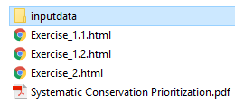
Software & Data
your folder
NOTE: everything in this PPT is in the Systematic Conservation Prioritization.pdf

Slide 11
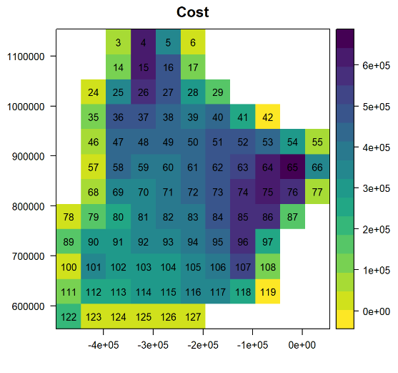
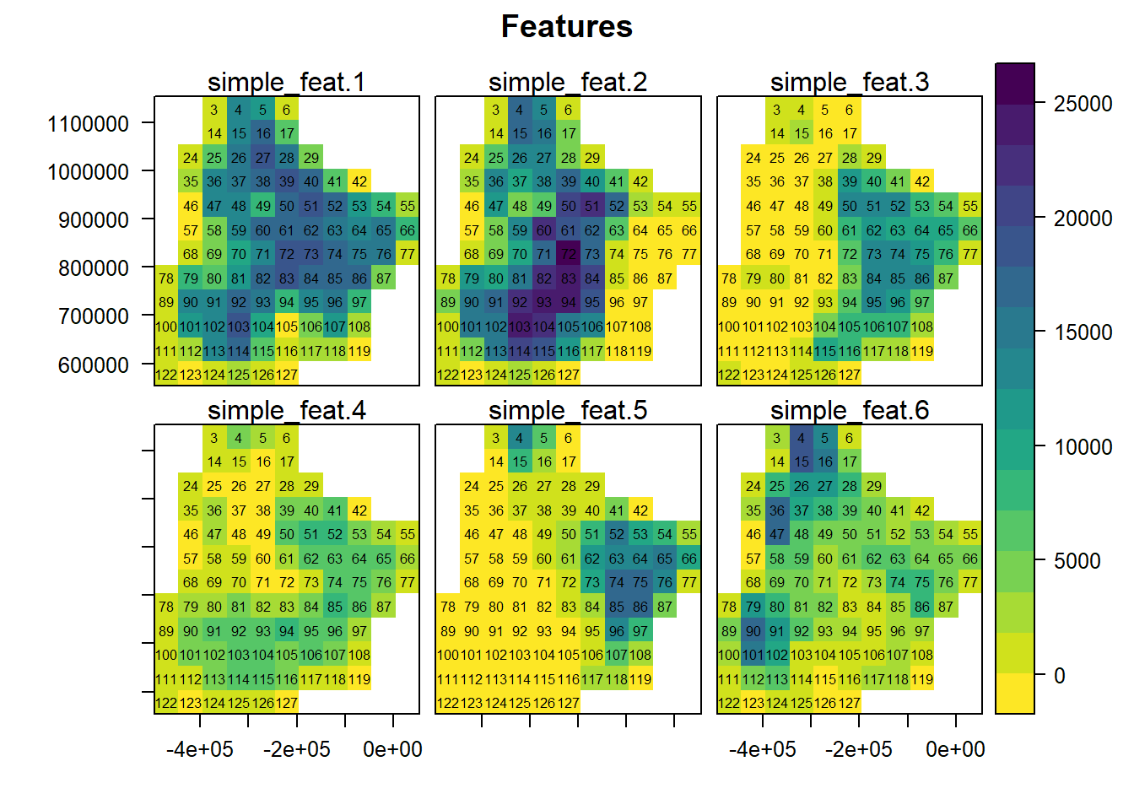
Simple example
Problem: Select a reserve network
Objective: Minimize cost
Targets: 17% of each species

Slide 12
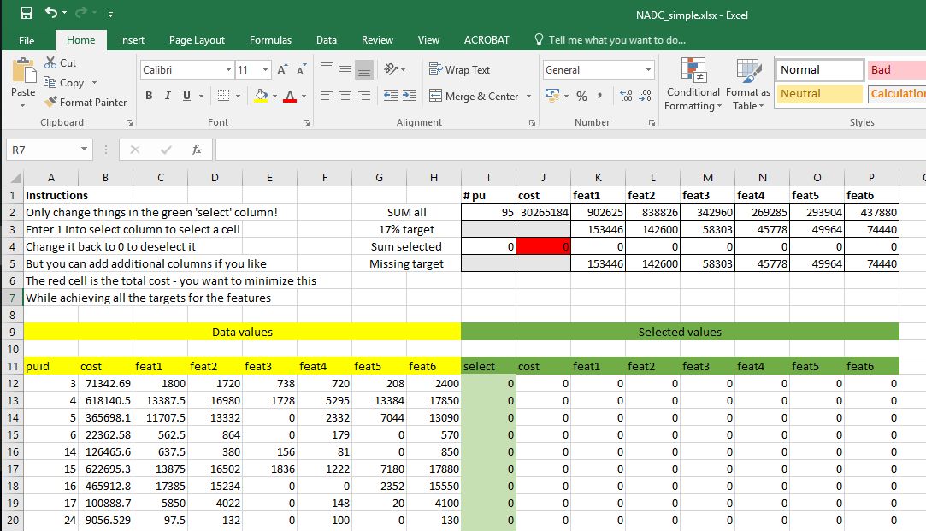
File: NADC_simple.xlsx
Problem: Select a reserve network
Objective: Minimize cost
Targets: 17% of each species
These are your targets
‘Achieved’ will increase as you select cells
Aim to get ‘missing’ to below zero
While minimizing cost
This is what each planning unit costs
And the benefits it gives
And values will show up here when selected

Slide 13
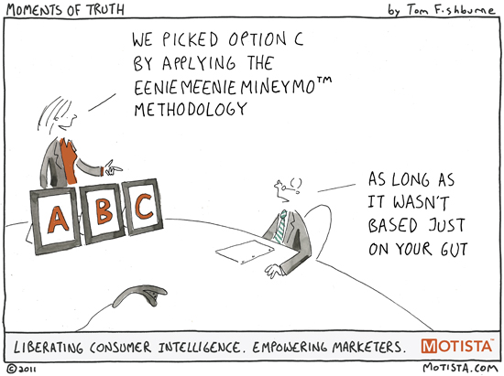
What strategies did you use?
Did you…
Minimize Cost / Benefit?
Maximize Benefit / cost?
Benefit = sum (all species) ?
Complementarity when some targets already reached?
Yes – there is software to do this easier!

Slide 14

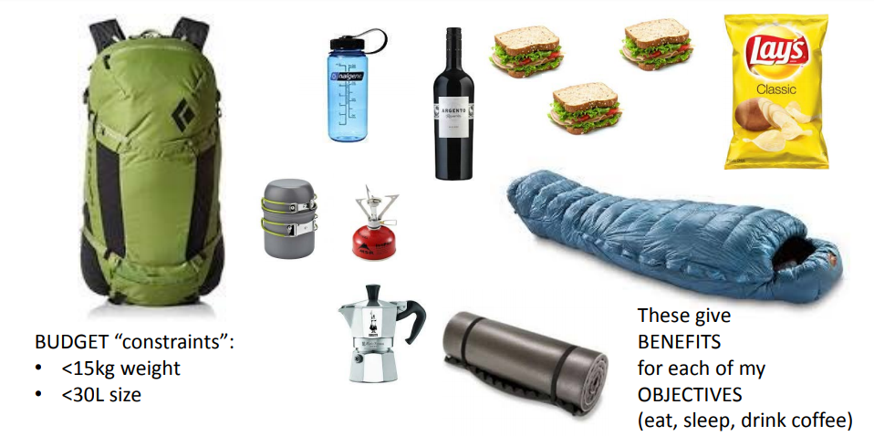
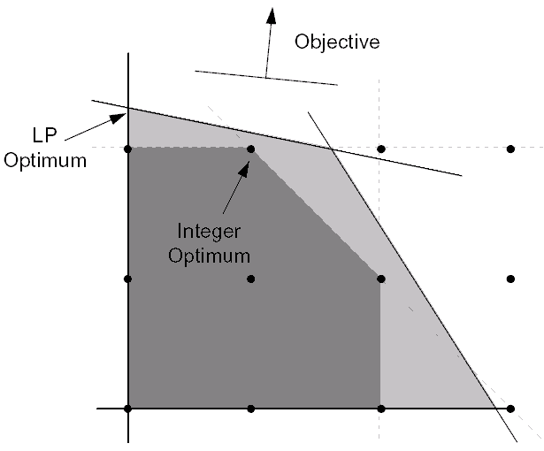
Problems and algorithms
Problem: The mathematical specification of the issue
e.g. the Minimum Set (knapsack) problem
Algorithm: the methods used to solve it
Heuristic methods
(random start and search solutions)
e.g. genetic algorithms, simulated annealing
Exact methods (identify solutions using math) e.g. Integer / Linear Programming

Slide 15

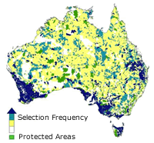
Existing software
http://marxan.org/
Problem: minimum set
Algorithm: simulated annealing

Slide 16

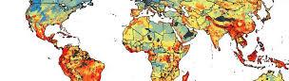
Existing software
https://www.helsinki.fi/en/researchgroups/metapopulation-research-centre/software#section-14300
Problem: …depends
Algorithm: set of greedy heuristics

Slide 17

Existing software
PrioritizR
https://CRAN.R-project.org/package=prioritizr
Problem: minimum set
Algorithm: Integer linear programming

Slide 18

Let’s see how well prioritizr can do on our problem
https://www.rstudio.com/
Open RStudio
Follow the instructions in Example_1.1.html

Slide 19
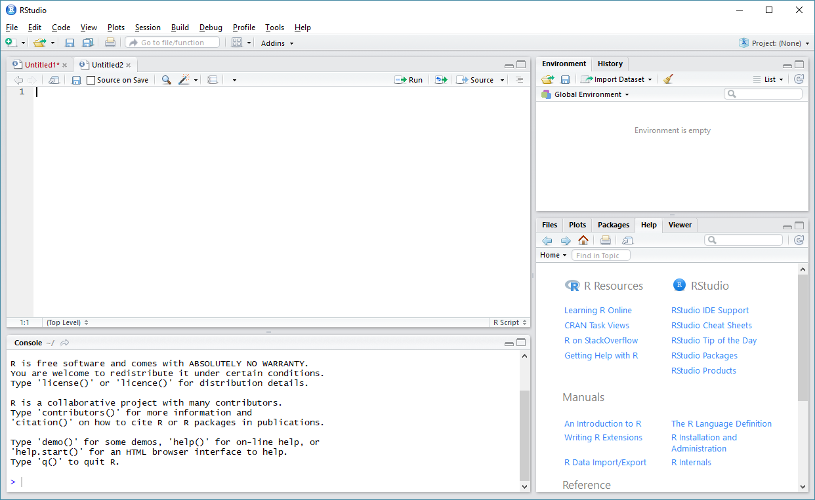
New script
save.r
(~txt file)
Run
https://www.rstudio.com/
Objects, history, etc.
Script editor
Help
Plots
Etc.
Console

Slide 20
What are the basics of R?
Object oriented programming language
# allocate numbers 1:5 to an object called ‘numbers1to5’
numbers1to5 <- 1:5
# ‘comments’
<- ‘assigns’
function()
?help
Can do basic math, etc
# add 1 and 2
1 + 2
# add 3 to each element of numbers1to5
newnumbers <- numbers1to5 + 3
Many functions available for simple and complex tasks
# plot numbers1to5 against the new numbers
plot(numbers1to5, newnumbers)

Slide 21
Example _1.1.html
Installs and loads packages (libraries of functions)
Specify where your data is (needs to be unzipped, and folder location corrected)
Load data
Check data loaded correctly
Specify the basic PrioritizR problem
Solve & examine results

Slide 22
Blank slide (so solution doesn’t show accidentally)

Slide 23
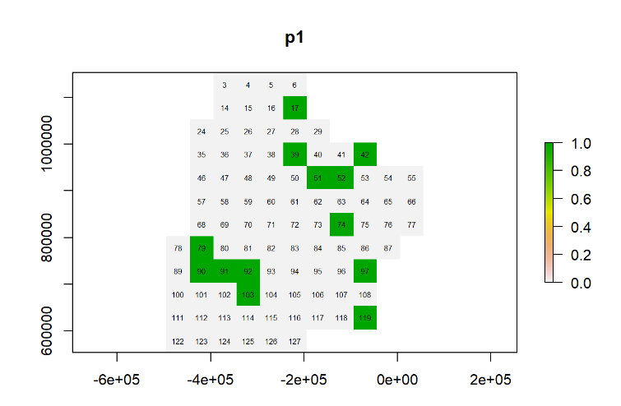
What did PrioritizR pick?
COST =
3 727 235

Slide 24
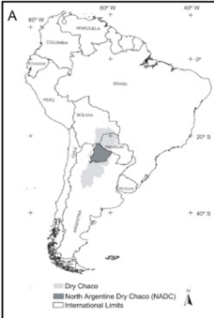
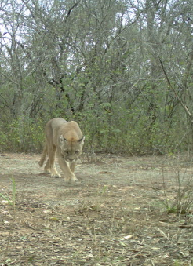
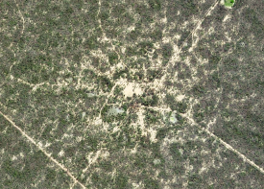
The North Argentinian Dry Chaco (NADC)
172 800km²
Semi-deciduous dry forest
46 tree spp.
>400 bird spp.
145 mammals
30 amphibians
Indigenous areas,
Livestock grazing,
Increasing agribusiness (soy, intensive pasture)
Satellite from GoogleMaps; Camera trap photos from INTA / Asun; Figure from Gasparri et al 2015 https://doi.org/10.1016/j.jaridenv.2015.05.005

Slide 25
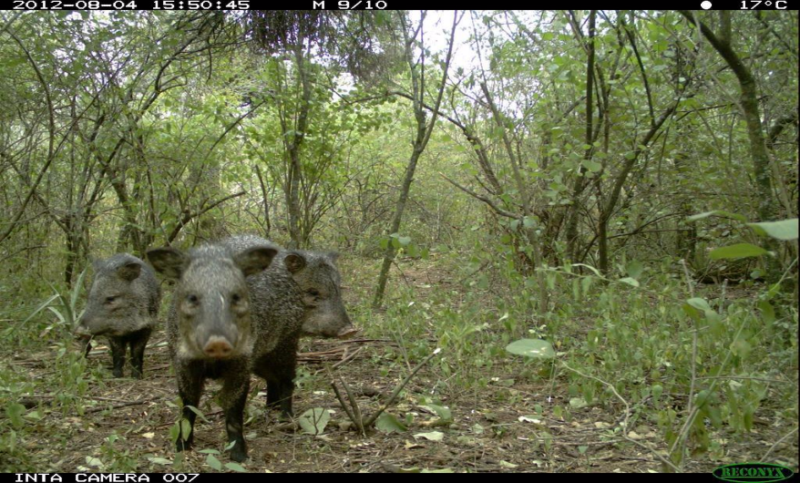
Driving questions
How can we balance production with biodiversity?
Where are the most important areas to protect?

Slide 26
Some terminology
Gap analysis
How much do the existing protected areas protect?
How much area do they cover?
How much of each species is missing?
Connectivity
Implemented as ‘boundary length penalty’
Adds a penalty to the cost, relative to the amount of exposed edges of the solution…

Slide 27
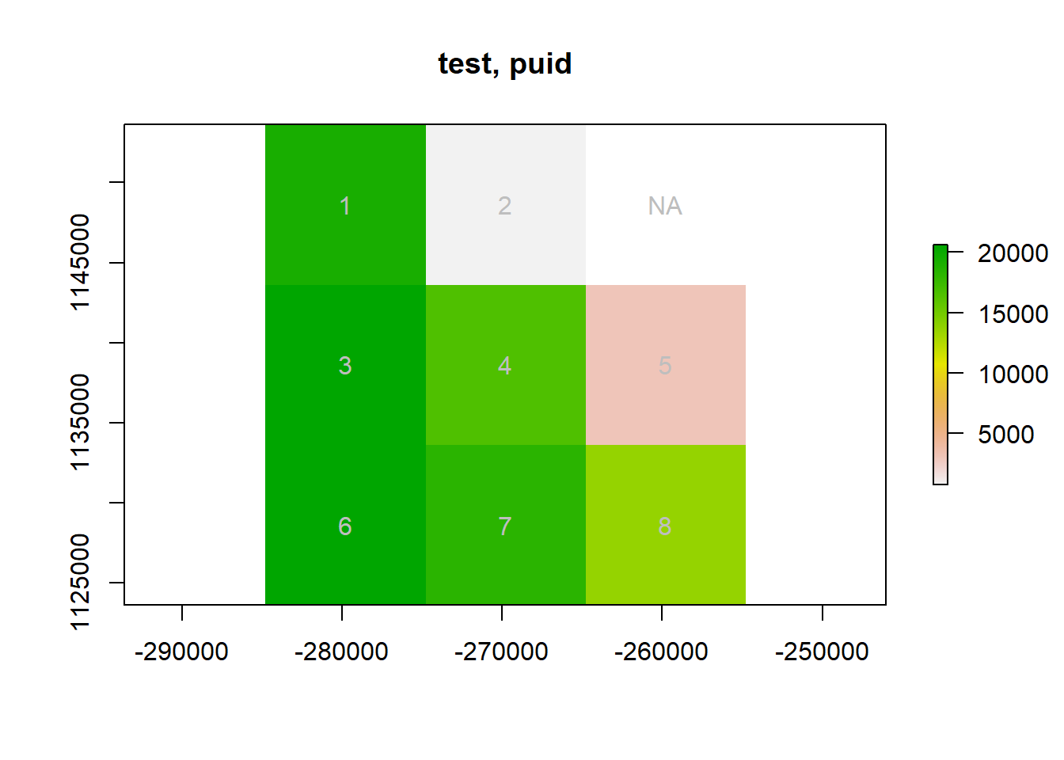
Some terminology
## 8 x 8 sparse Matrix of class "dsCMatrix"
##
## [1,] 20000 10000 10000 . . . . .
## [2,] 10000 20000 . 10000 . . . .
## [3,] 10000 . 10000 10000 . 10000 . .
## [4,] . 10000 10000 . 10000 . 10000 .
## [5,] . . . 10000 20000 . . 10000
## [6,] . . 10000 . . 20000 10000 .
## [7,] . . . 10000 . 10000 10000 10000
## [8,] . . . . 10000 . 10000 20000

Slide 28
NADC PrioritizR exercises
Exercise_2.html
Open R via RStudio
Install and load the required packages
Load and explore the 10km resolution data
Conduct a simple ‘gap analysis’
Construct a PrioritizR problem, with lock in and lock out options
Solve this, and explore the solutions
Add connectivity constraints to the problem
Solve, and explore the solutions
Remember: this is not a course on R! We can help with the code, but we want you to understand the concepts.

Slide 29
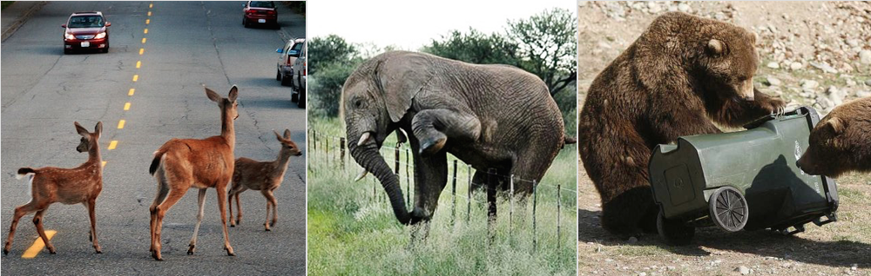
Scenarios
big
Represent common considerations when designing a reserve system
How do costs / areas change when the targets change?
How well might some species proxy for others?
SLOSS issues
How can we plan for avoiding / mitigating conflict?
intact
close
clumped
connected
Less edge

Slide 30
NADC PrioritizR exercises
Scenarios.html
Changing the relative targets
Focus on different species groups
Connectivity
Lock in – Lock out
A portfolio of solutions
Remember: this is not a course on R! We can help with the code, but we want you to understand the concepts.

Slide 31
Discussion points
Assumptions
Will the reserves we allocate protect the species?
Will they be effectively implemented?
Will an ‘effective’ reserve be the right action for each species?
Will the species selected be a good proxy for all biodiversity?
Alternative/additional features
Habitat types (as proxy for biodiversity)
Ecological processes – e.g. catchments, ecotones
Ecosystem services – e.g. carbon, flood protection
Cultural/social services

